Slide 1
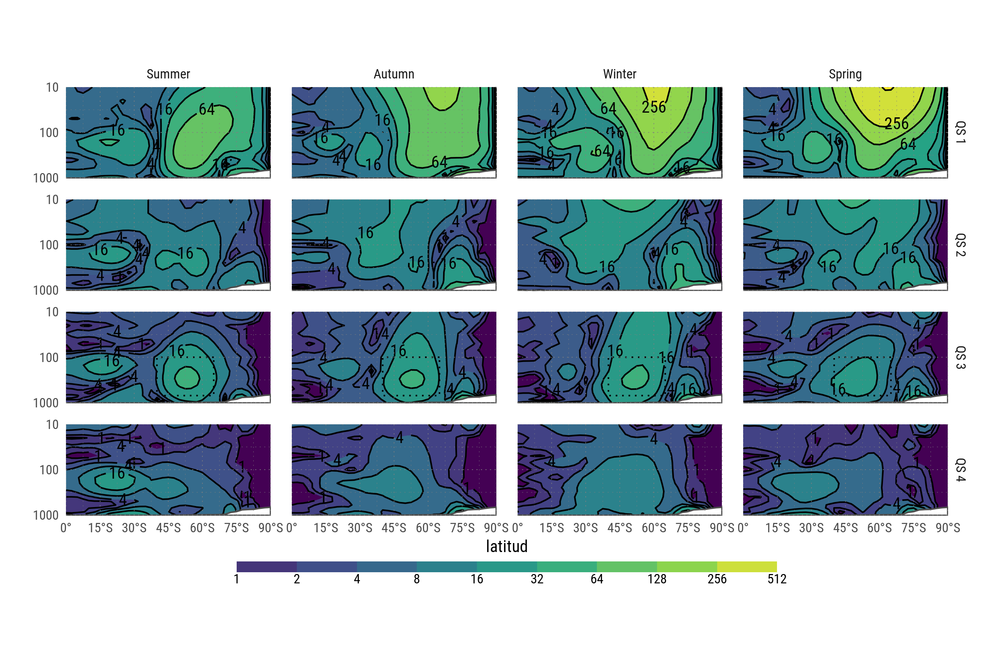
Fourier amplitude of geopotential height

Slide 2
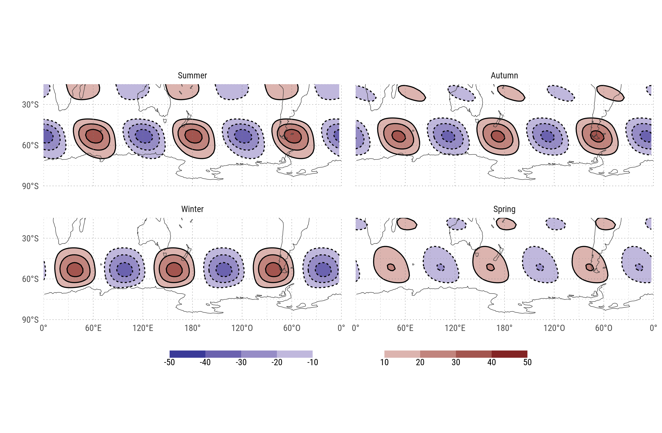
Wave 3 component of the geopotential field of each season at 200hPa.

Slide 3
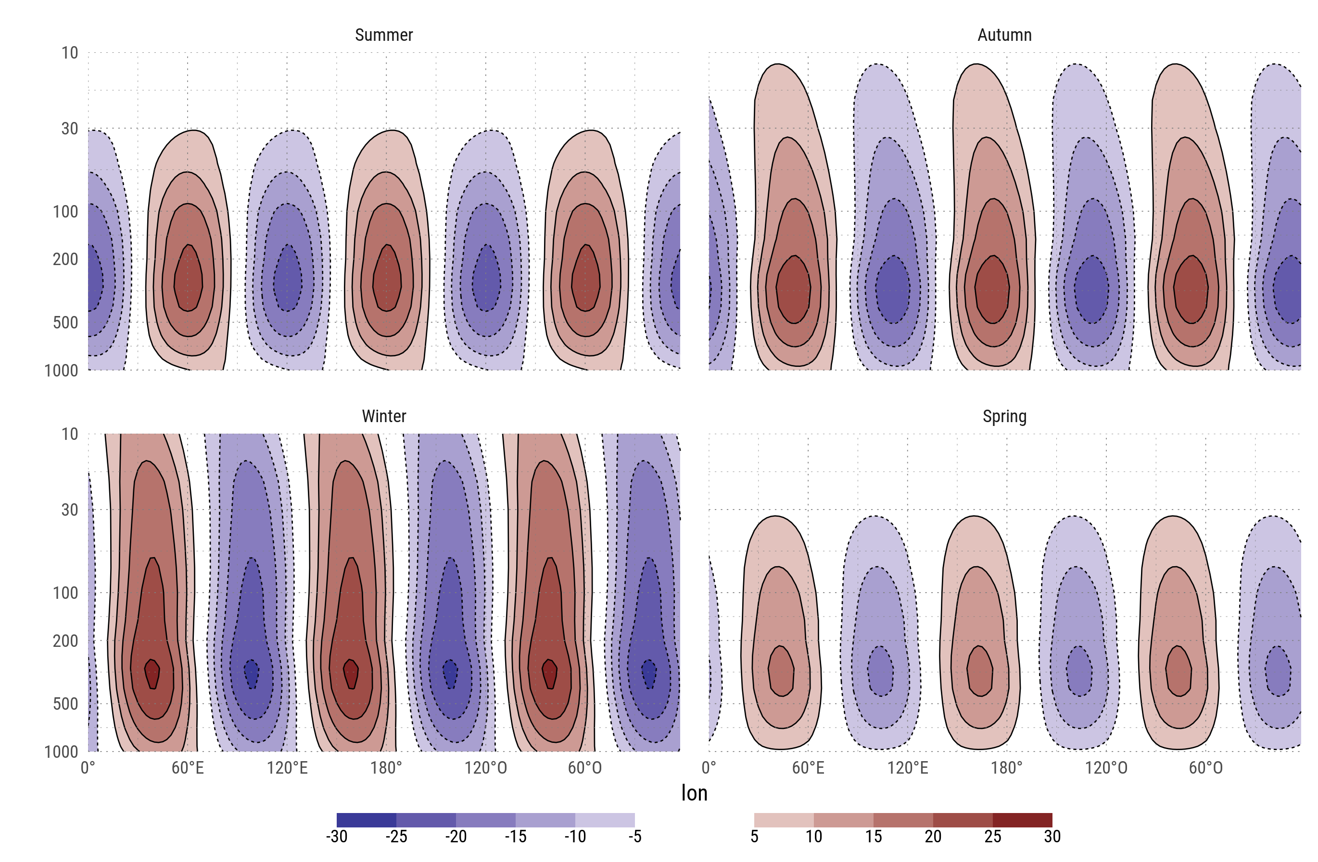
Mean wave 3 component of geopotential height between 65°S and 35°S

Slide 4
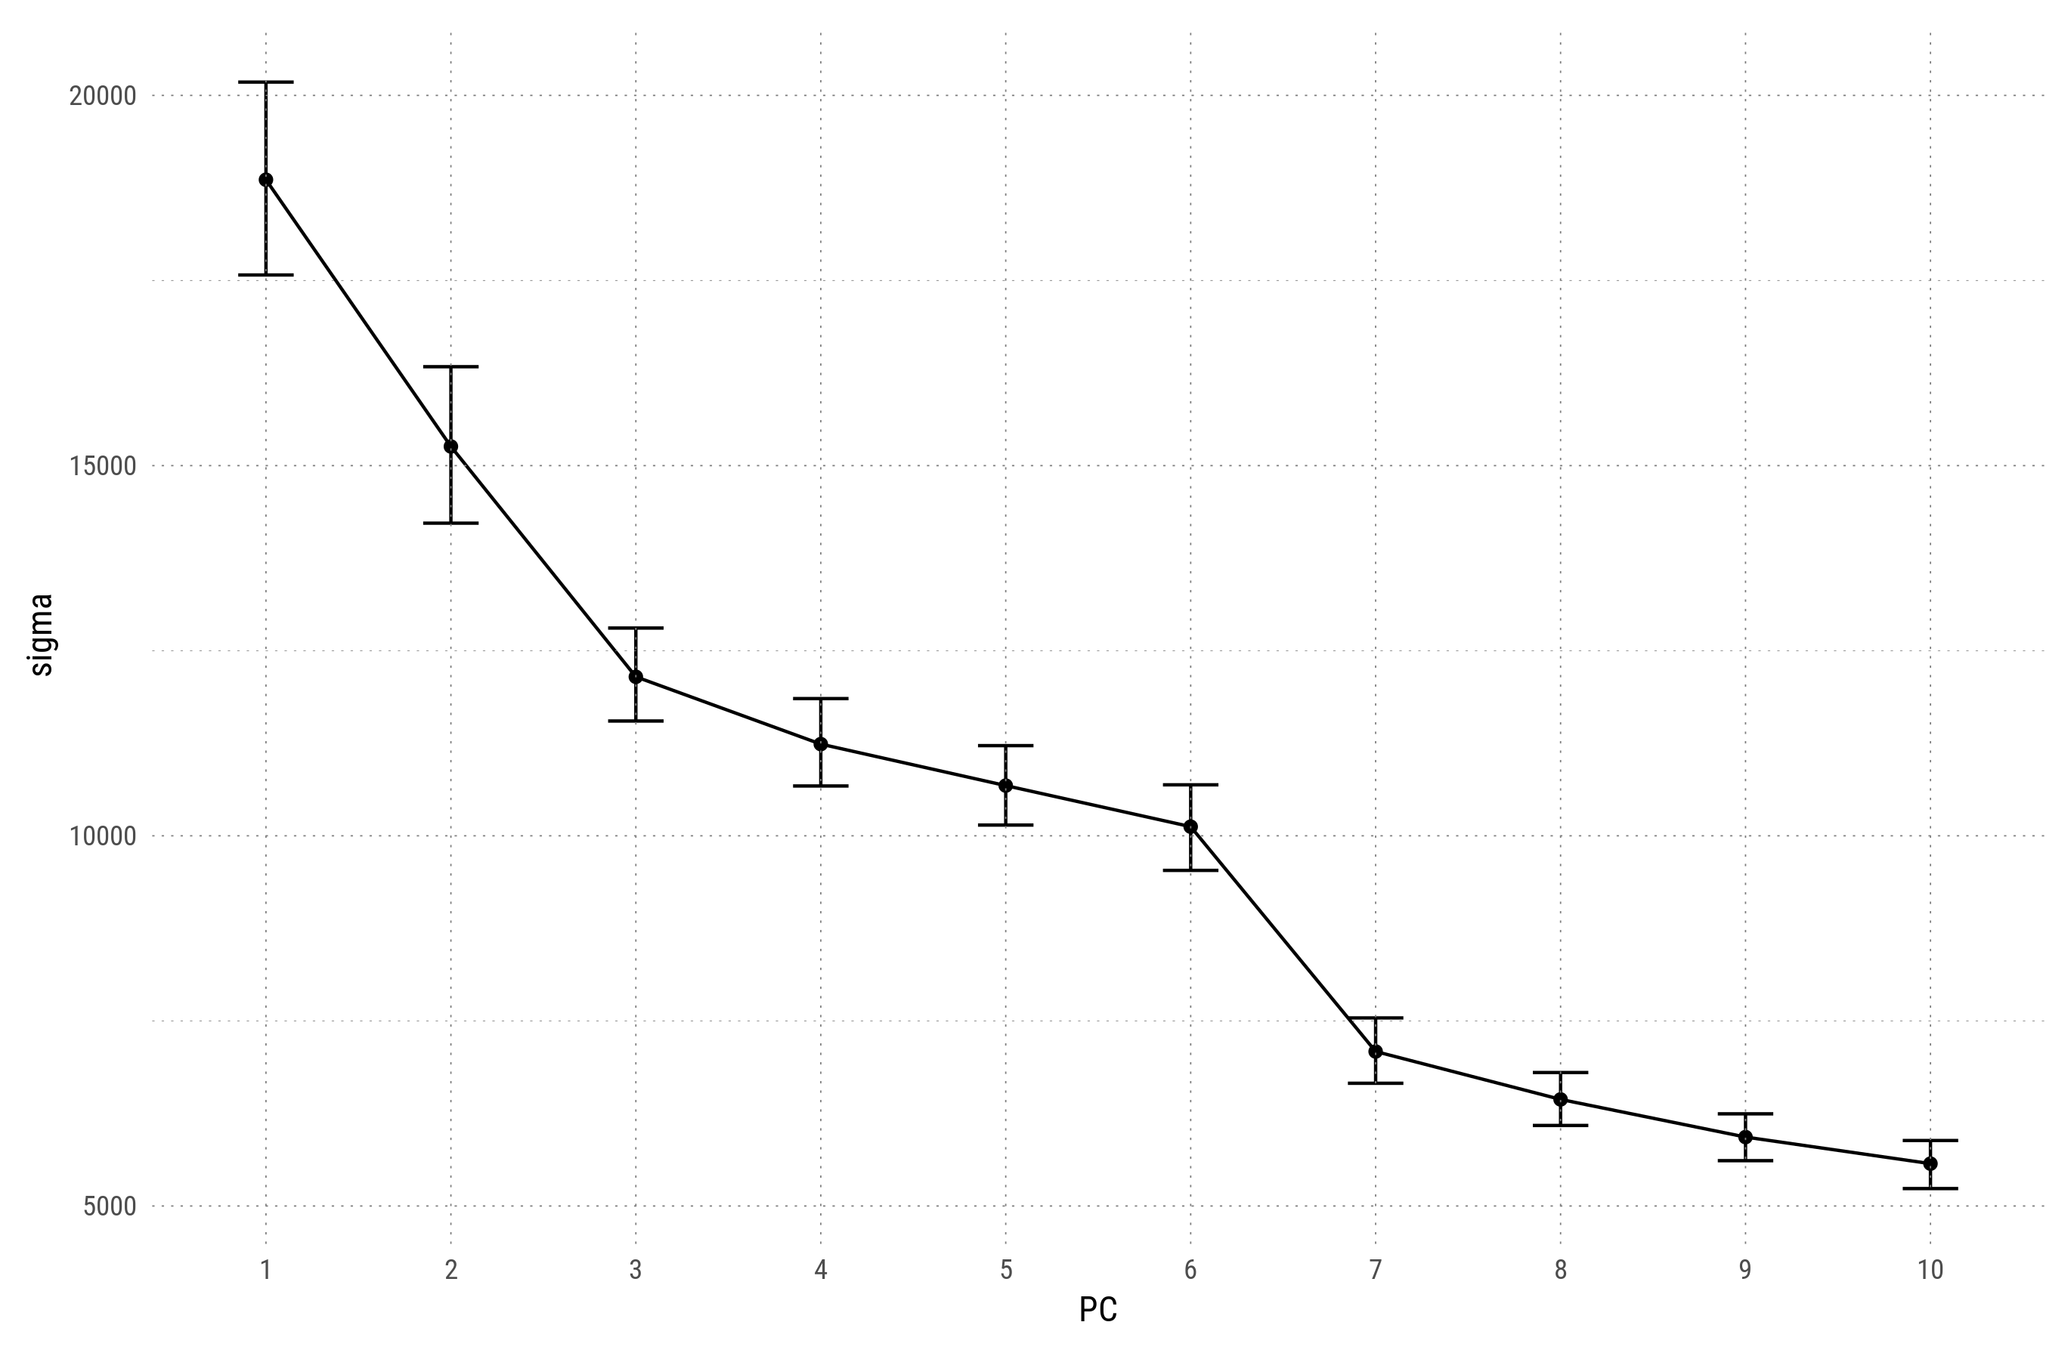
First 4 EOFs derived from the 200hPa detrended geopotential zonal anomaly field between 30°S and 80°S with zonal wave 1 filtered out. Erros bars represent the 95% cuantile range estimated via bootstrap.

Slide 5
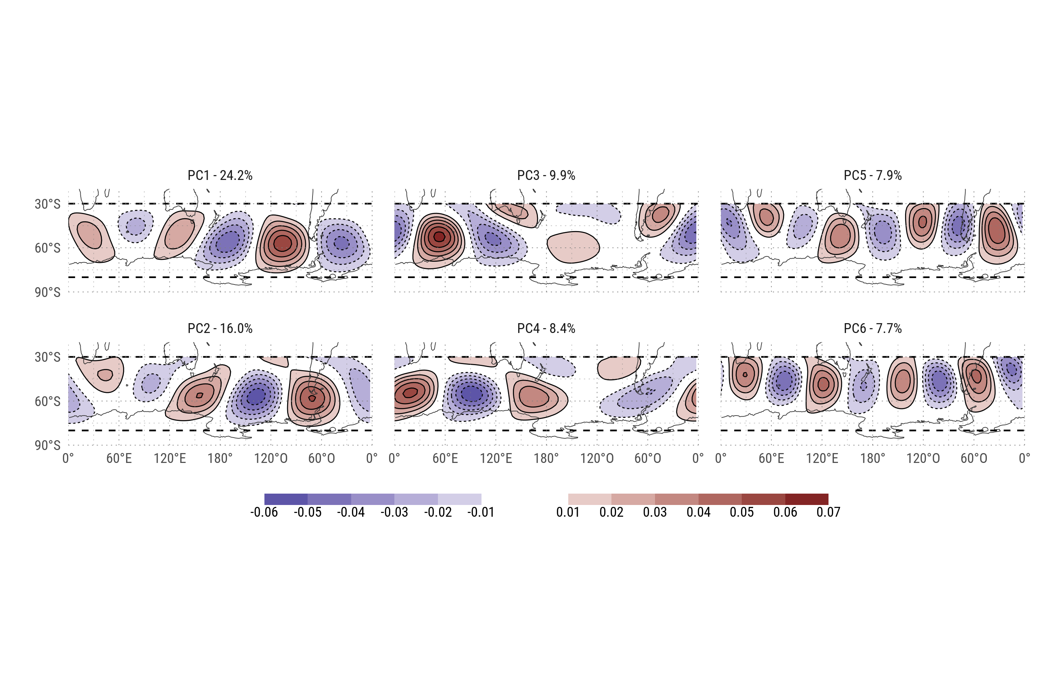
EOFs

Slide 6
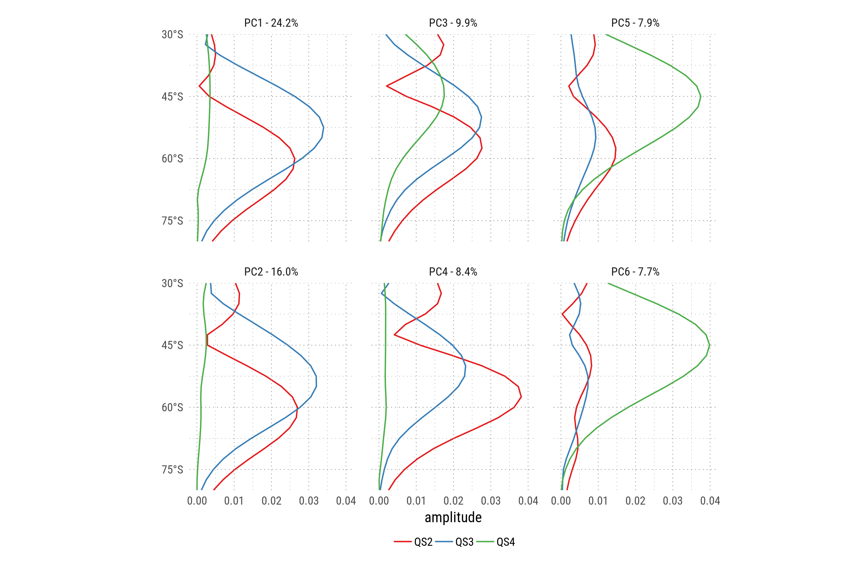
Fourier decomposition by latitude of each EOF.

Slide 7
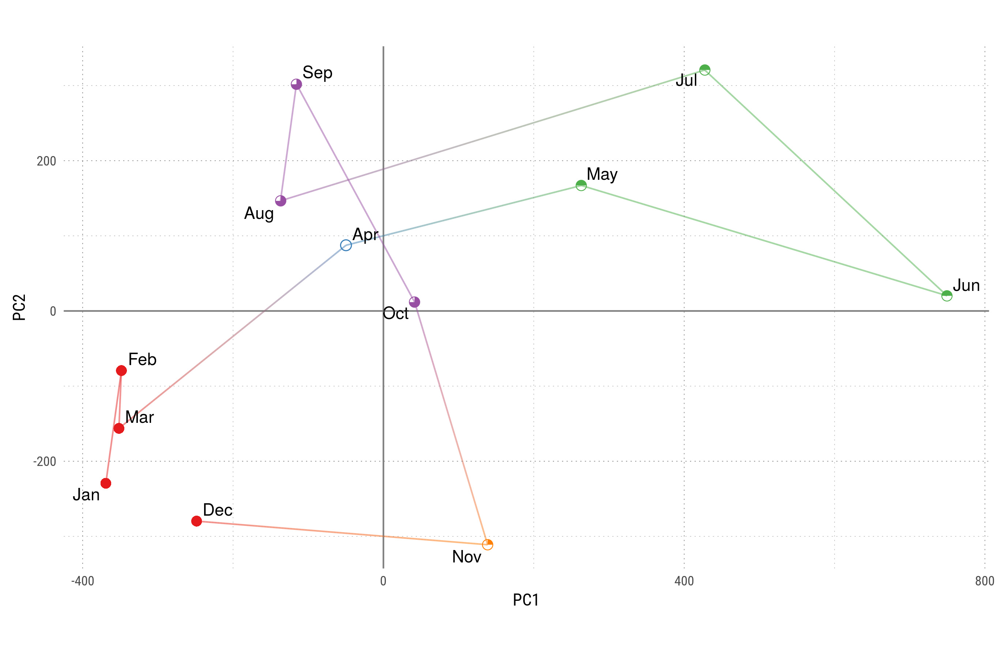
Monthly mean values for each PC. Colors and shapes divide months into 5 'seasons'.

Slide 8
Cluster Dendrogram
1200
1000
800
Height
600
400
200
0
Jun
May
Jul
Nov
Dec
Feb
Jan
Mar
Aug
Sep
Apr
Oct
.
hclust (*, "complete")
Hierarchical clustering of the months of the year according to the mean value of each PC scaled by it's variance.

Slide 9
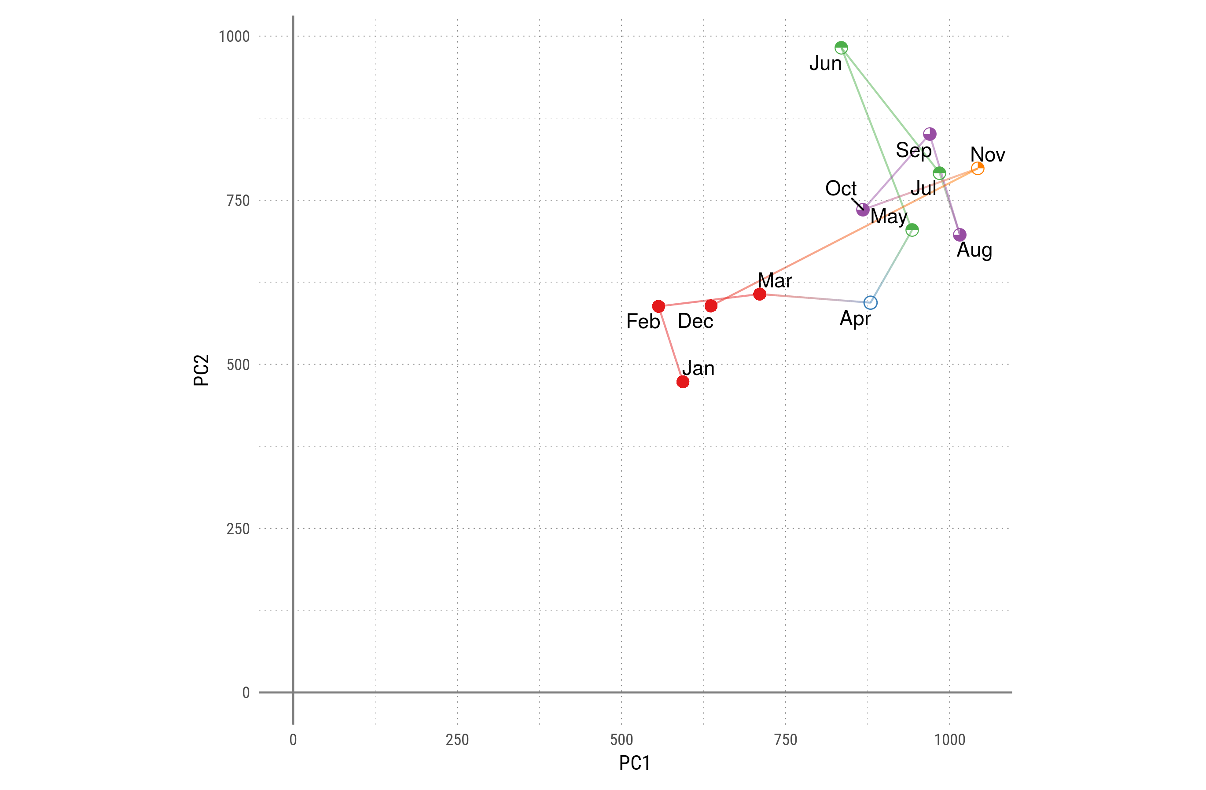
Monthly standard deviation for each PC. Colors and shapes divide months into 5 'seasons'.

Slide 10
Cluster Dendrogram
700
600
500
400
Height
300
200
100
Mar
Apr
Dec
Jan
Feb
Jun
Aug
Oct
May
Jul
Sep
Nov
.
hclust (*, "complete")
Hierarchical clustering of the months of the year according to the standard deviation of each PC scaled by it's variance.

Slide 11
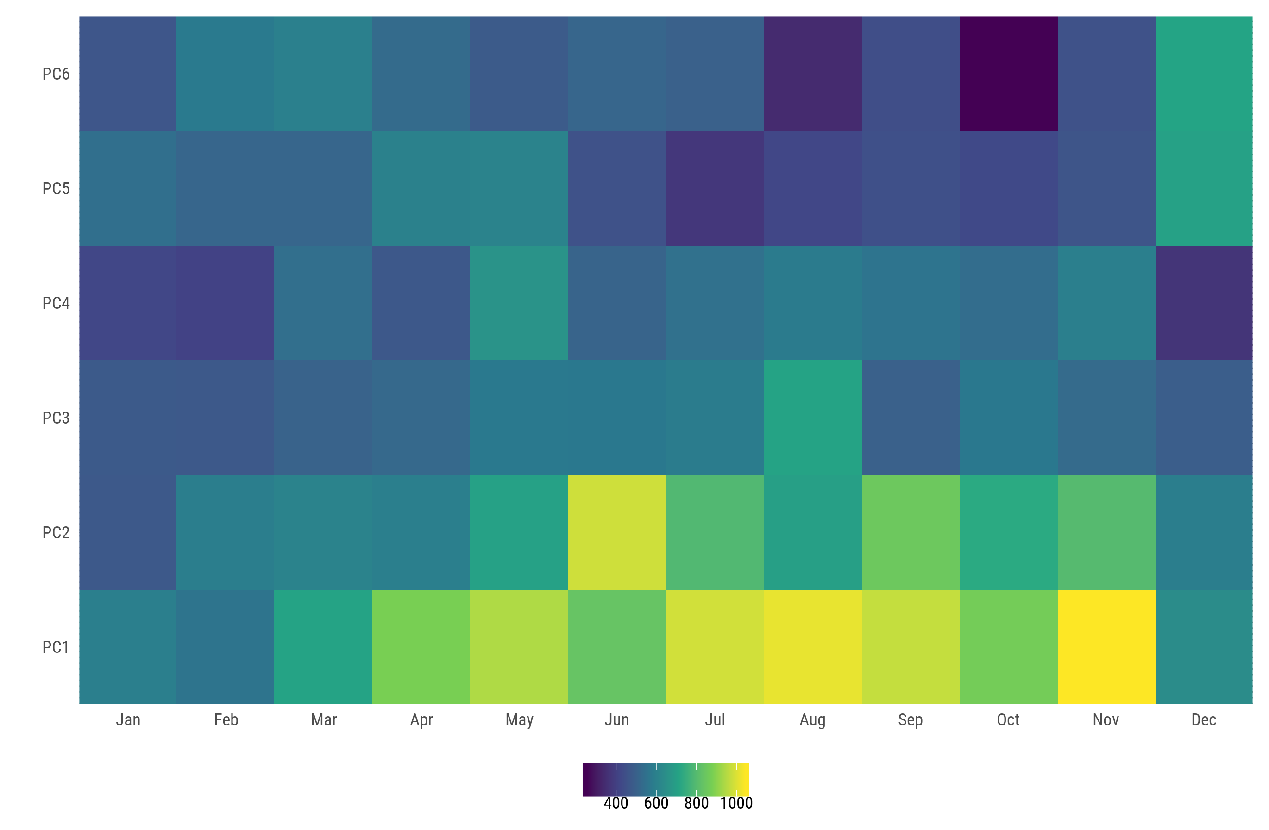
Standard deviation (scaled by their variance) of each PC for each month

Slide 12
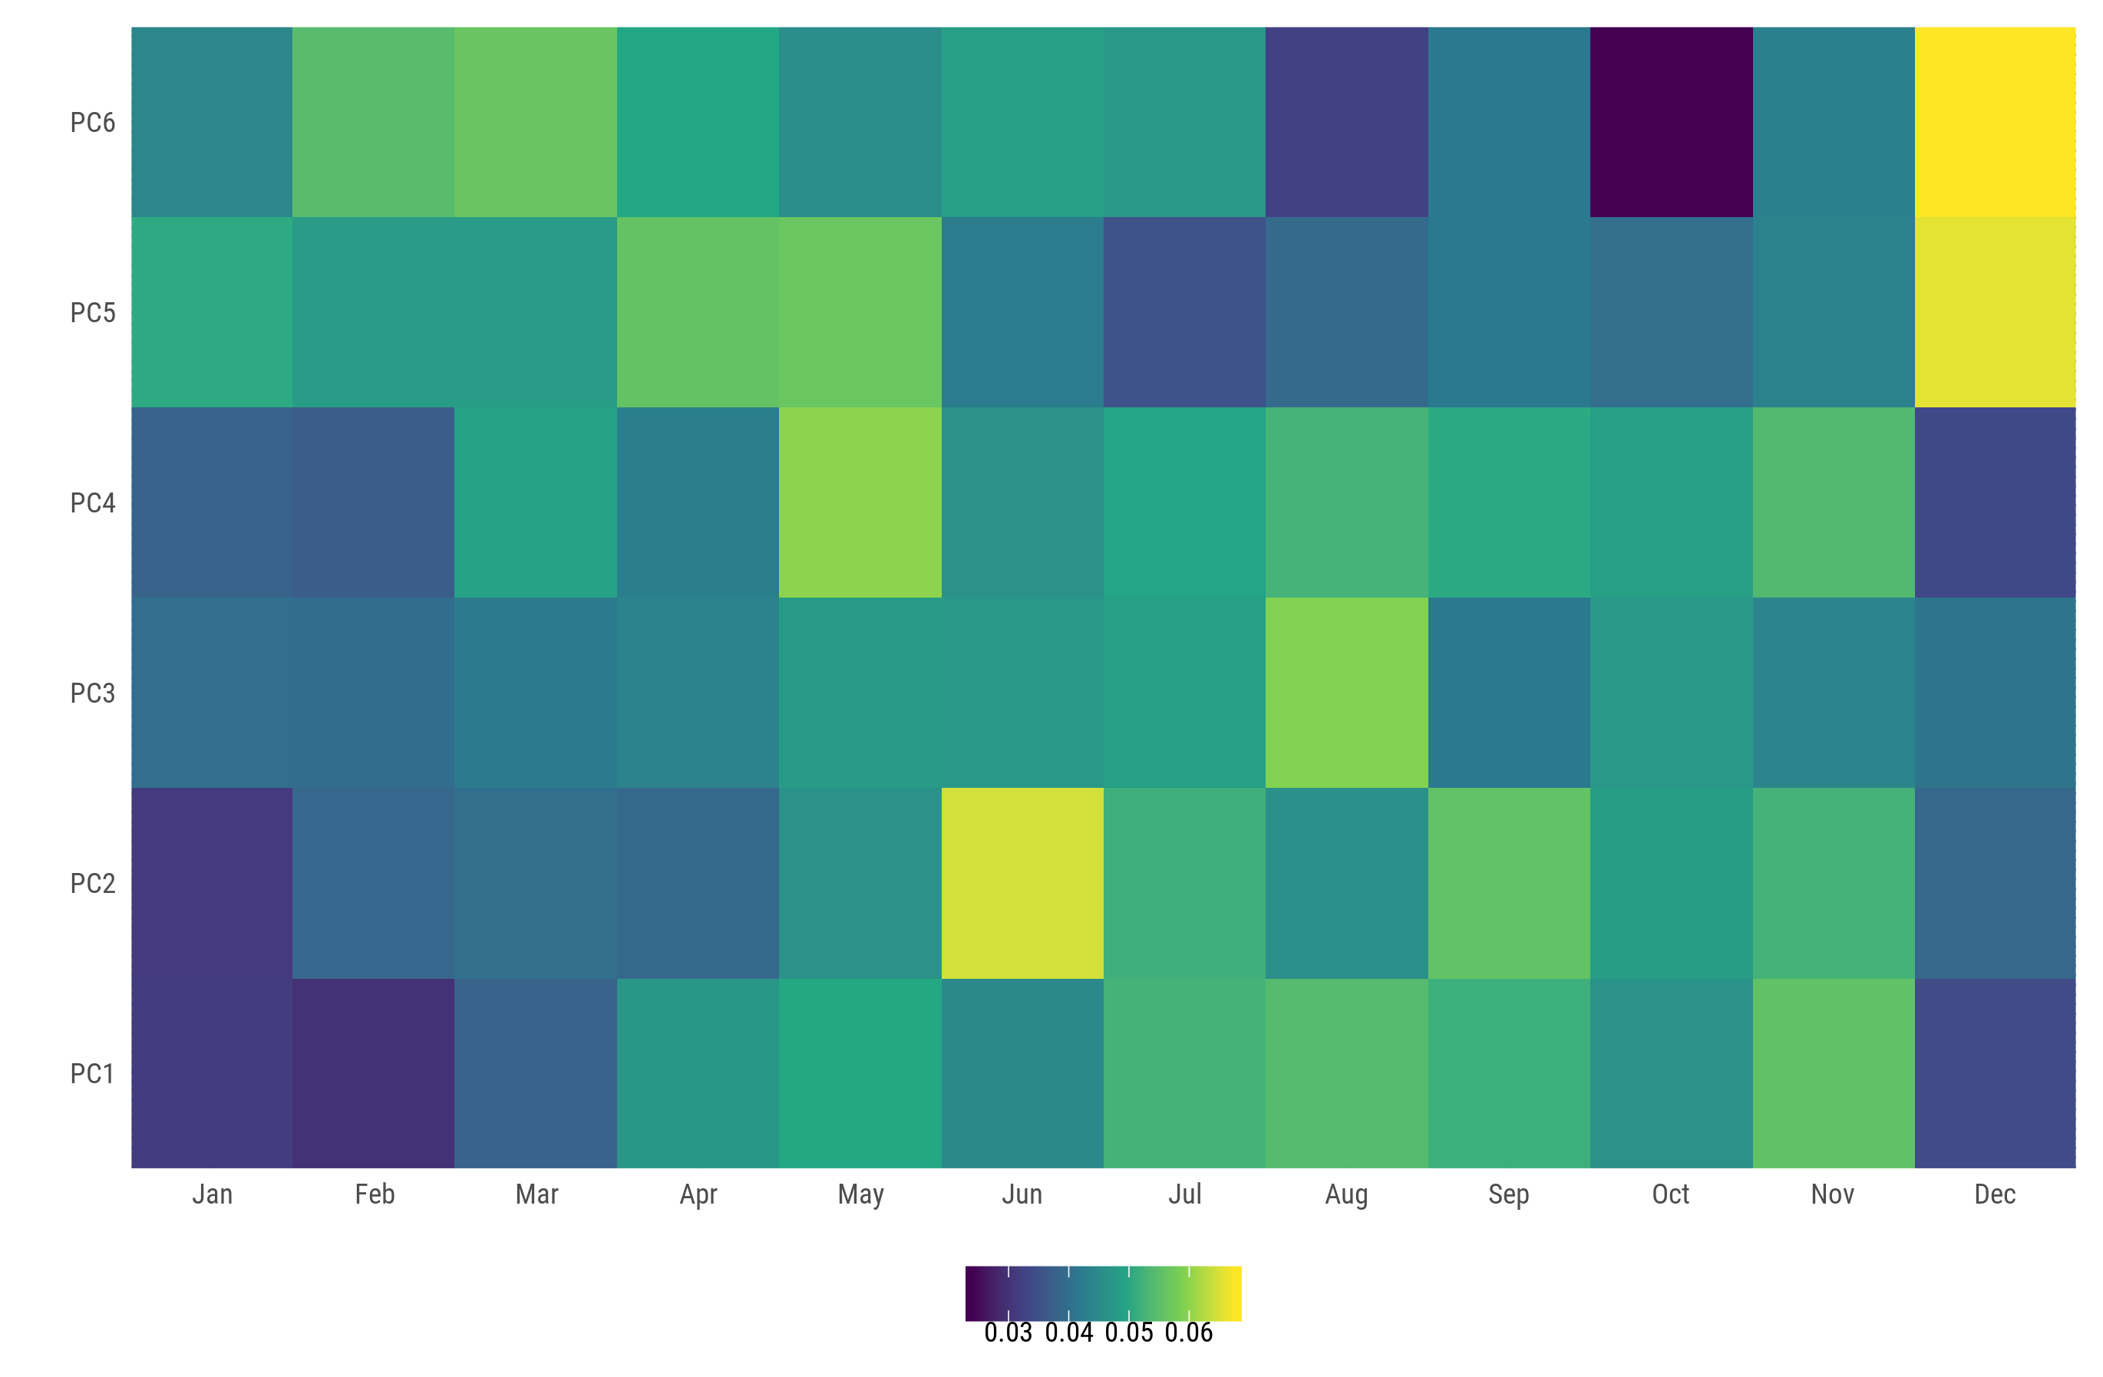
Standard deviation of each PC for each month

Slide 13
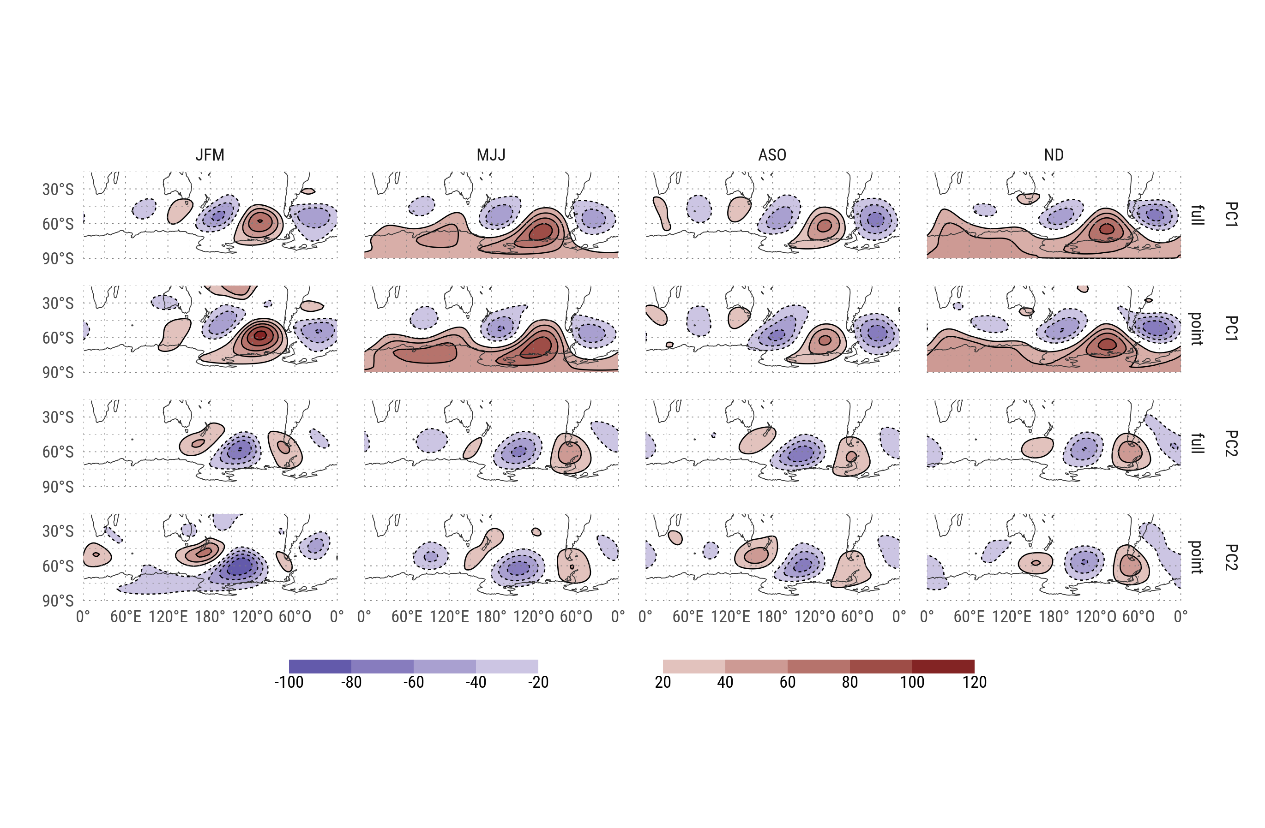
(standarized) Regression between PCs and gh.

Slide 14
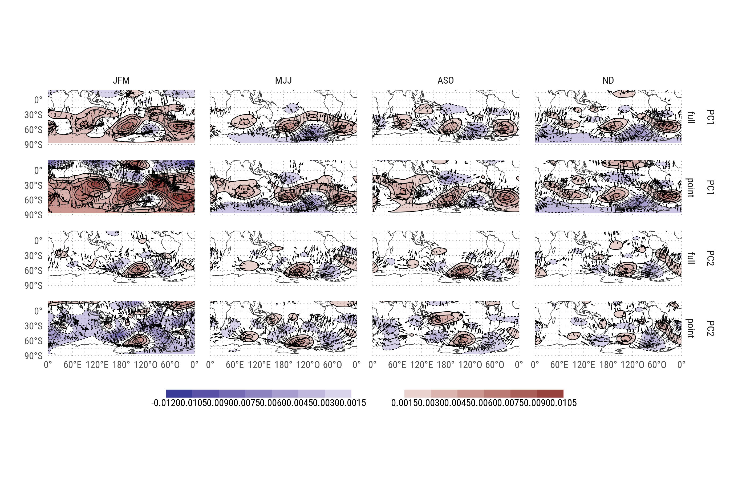
Regression between PCs and Psi.

Slide 15
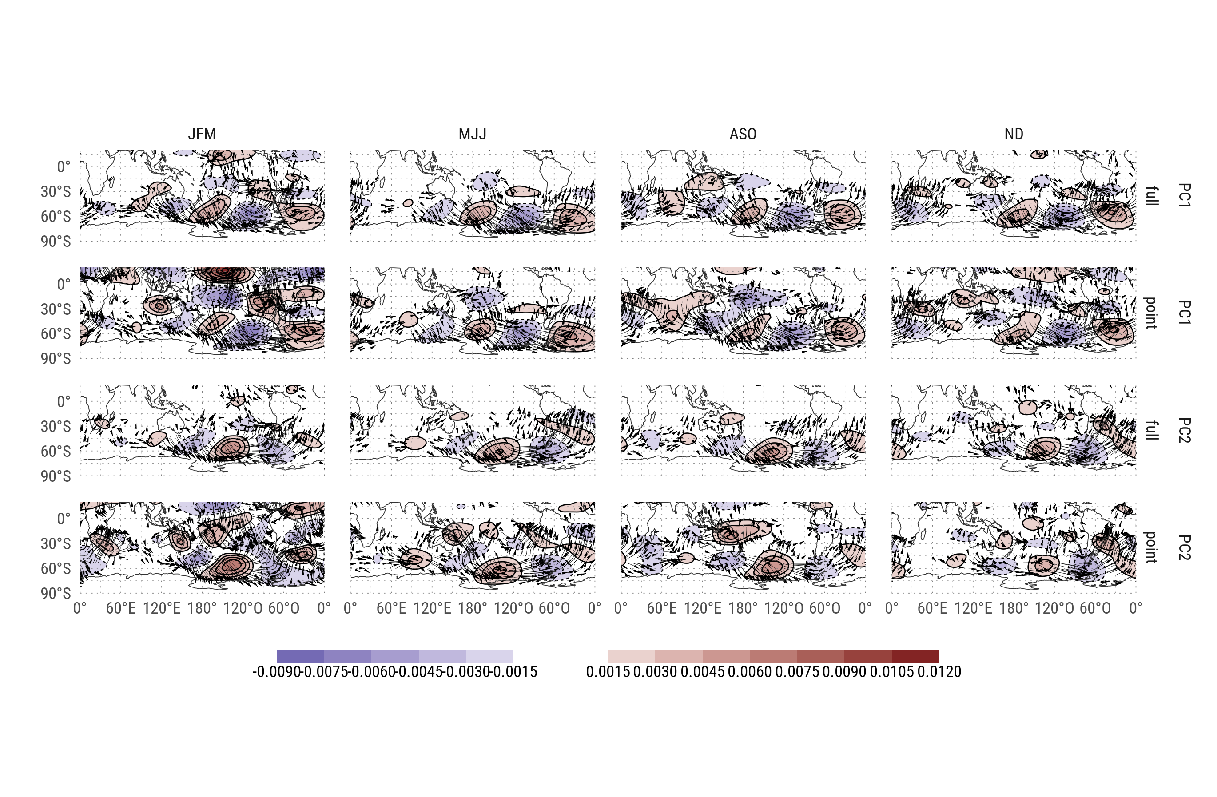
Zonal anomaly of regression between PCs and Psi.

Slide 16
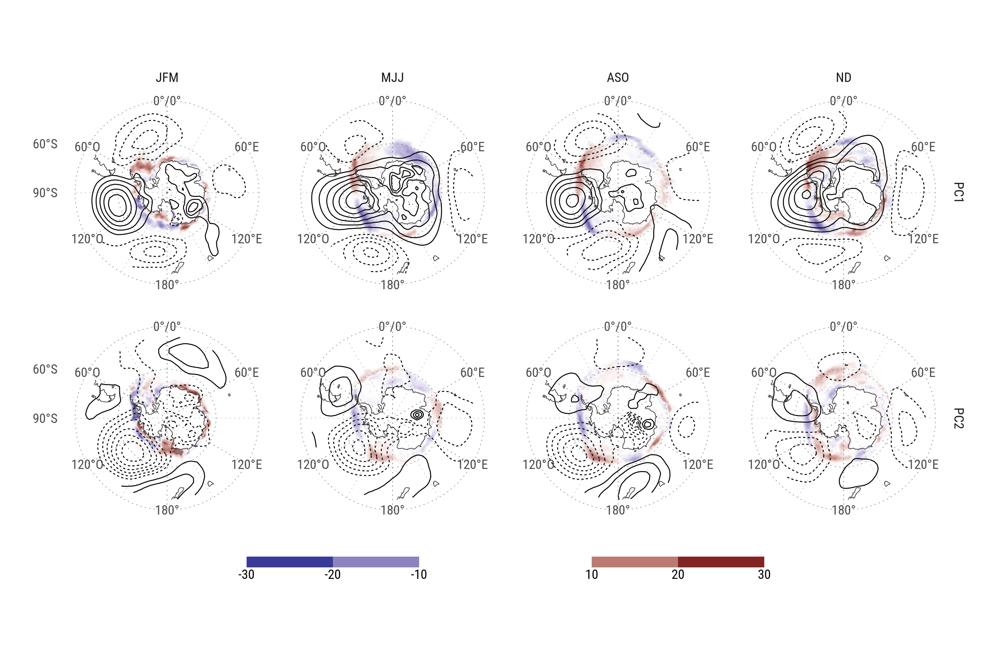
Regression of standarized PC with antarctic sea ice concentrations (shaded) and regression of standarized PC with SLP (contours).

Slide 17
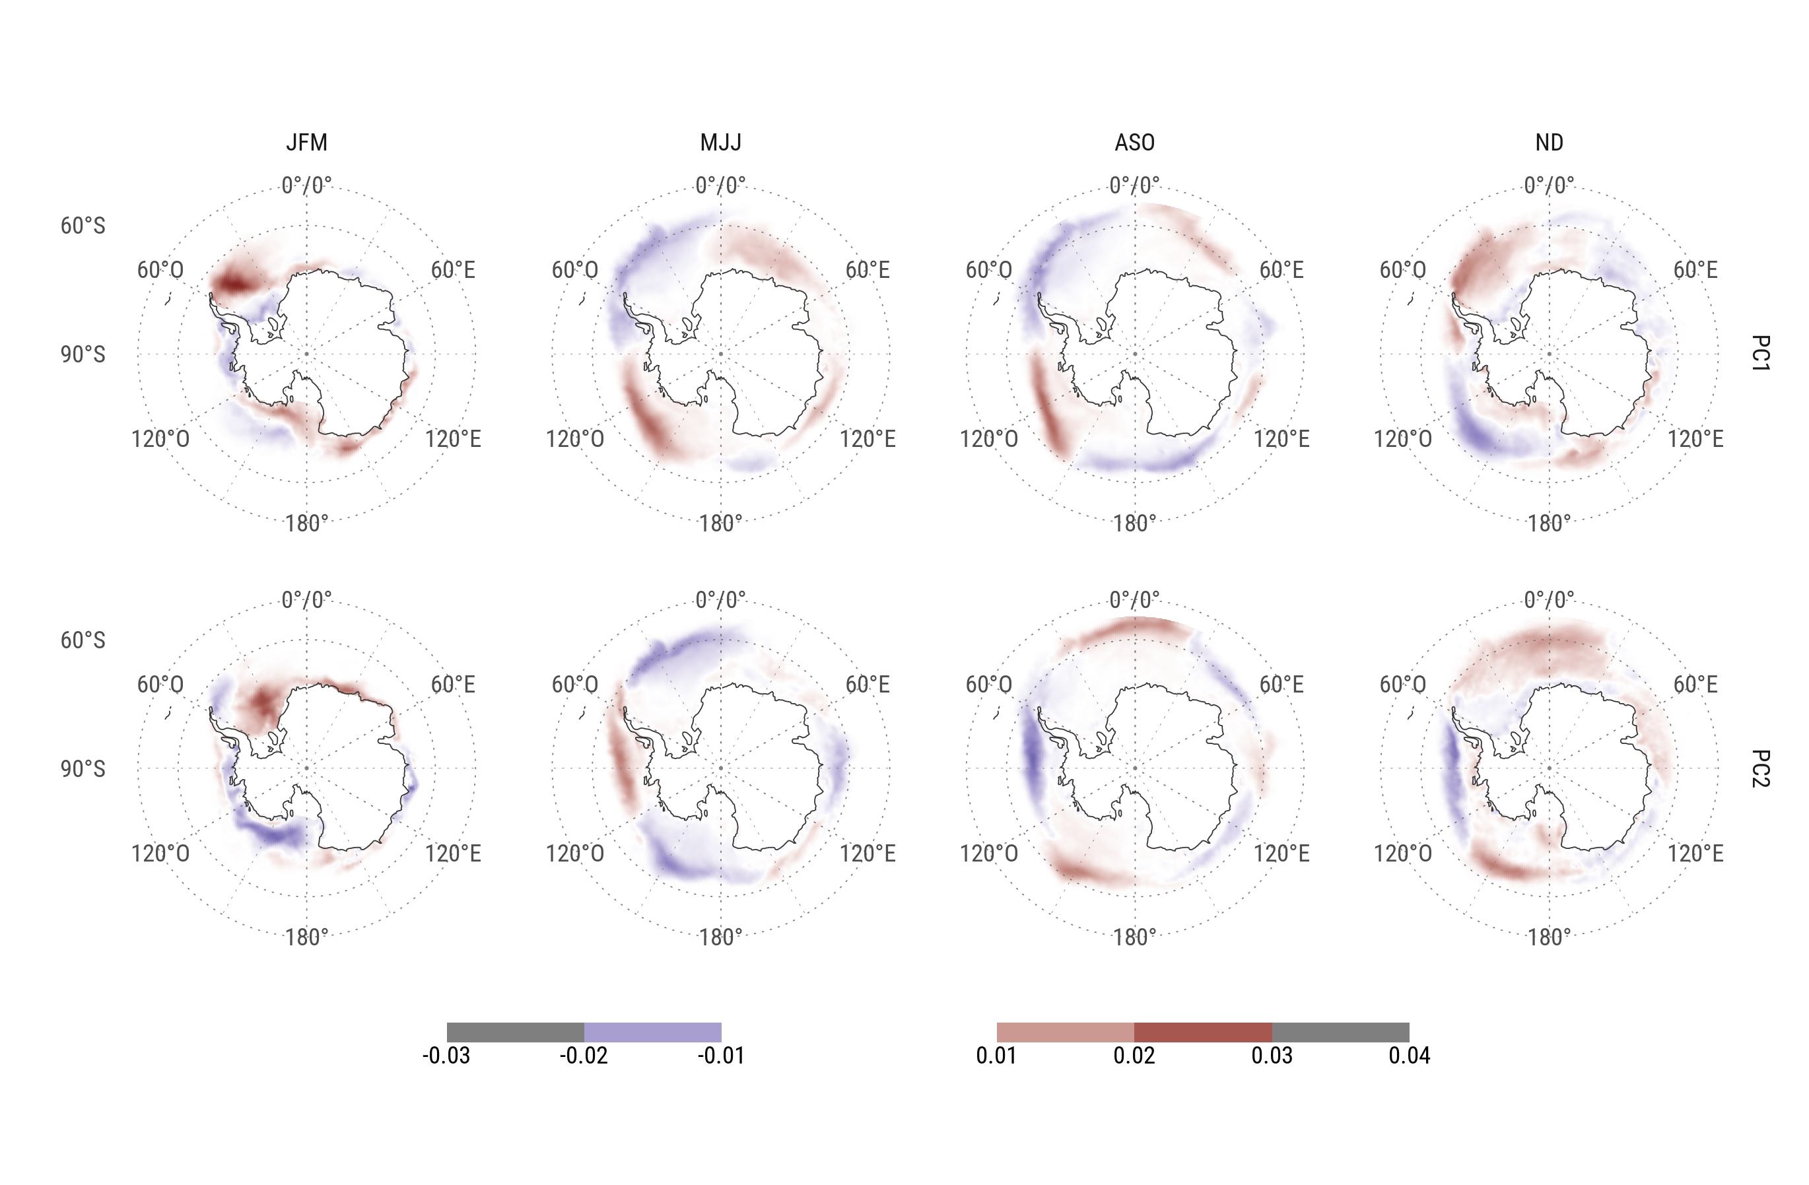
First 2 EOFs of antarctic sea ice concentration for each season (shaded) and regression of standarized PC (of geopotential) with 200hPa geopotential height (contours)

Slide 18
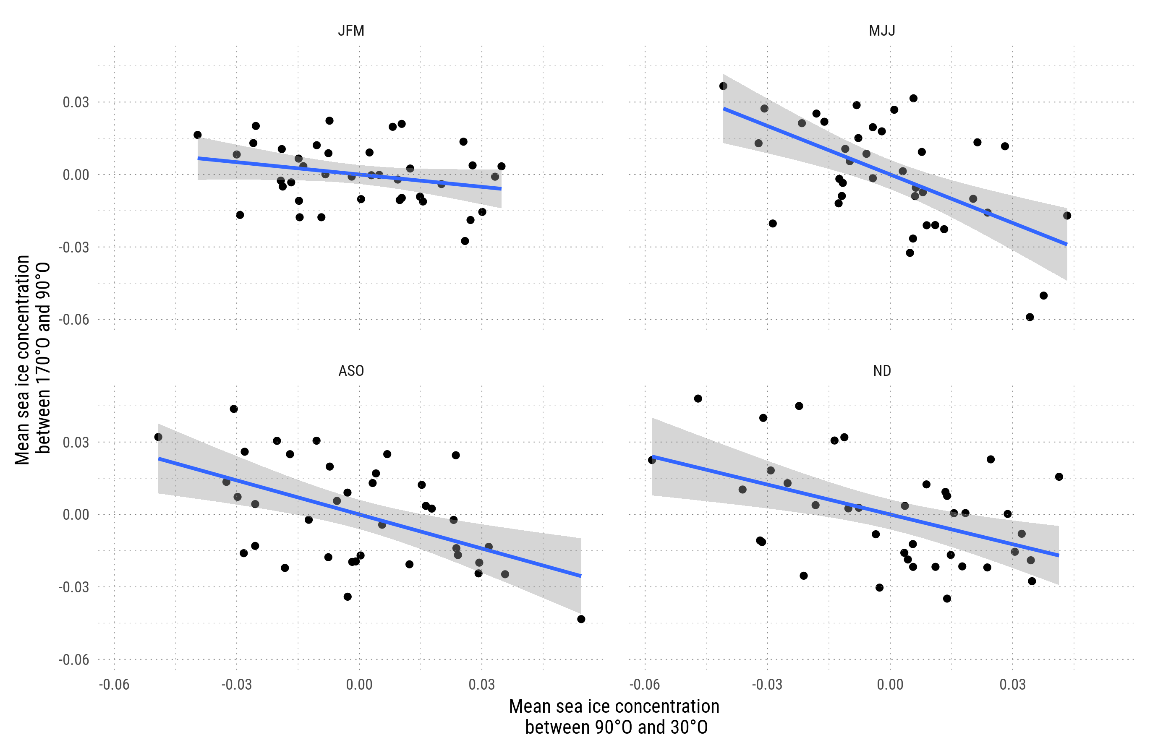
Mean sea ice concentration at the east of 90°W vs. at the west.

Slide 19
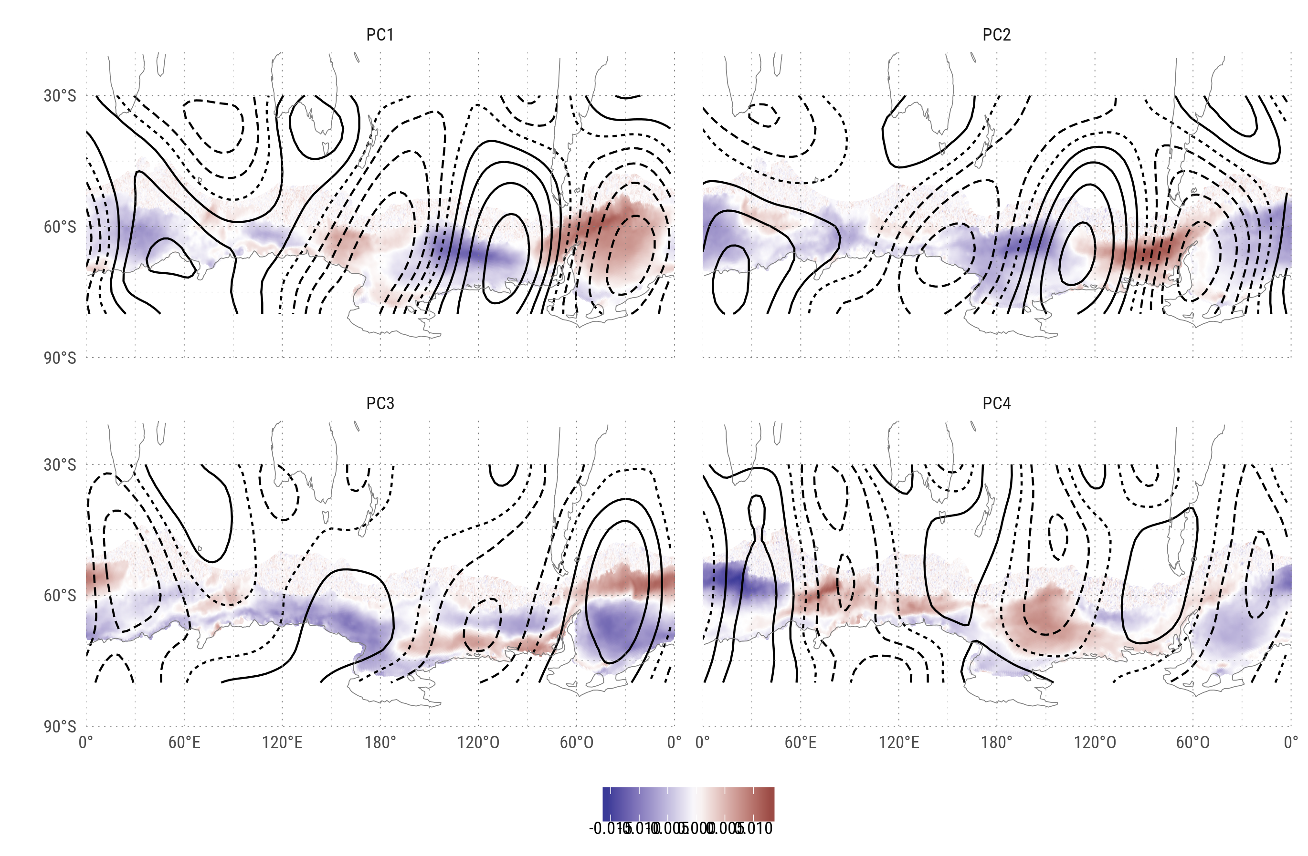
Joit EOF of filtered geopotential height and antarctic sea ice concentration.

Slide 20
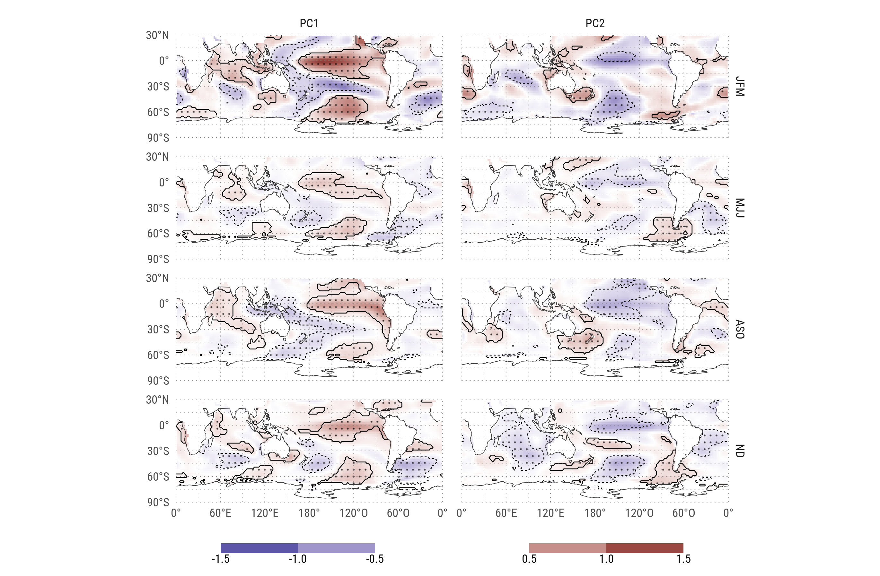
Regression of standarized PC with SST.

Slide 21
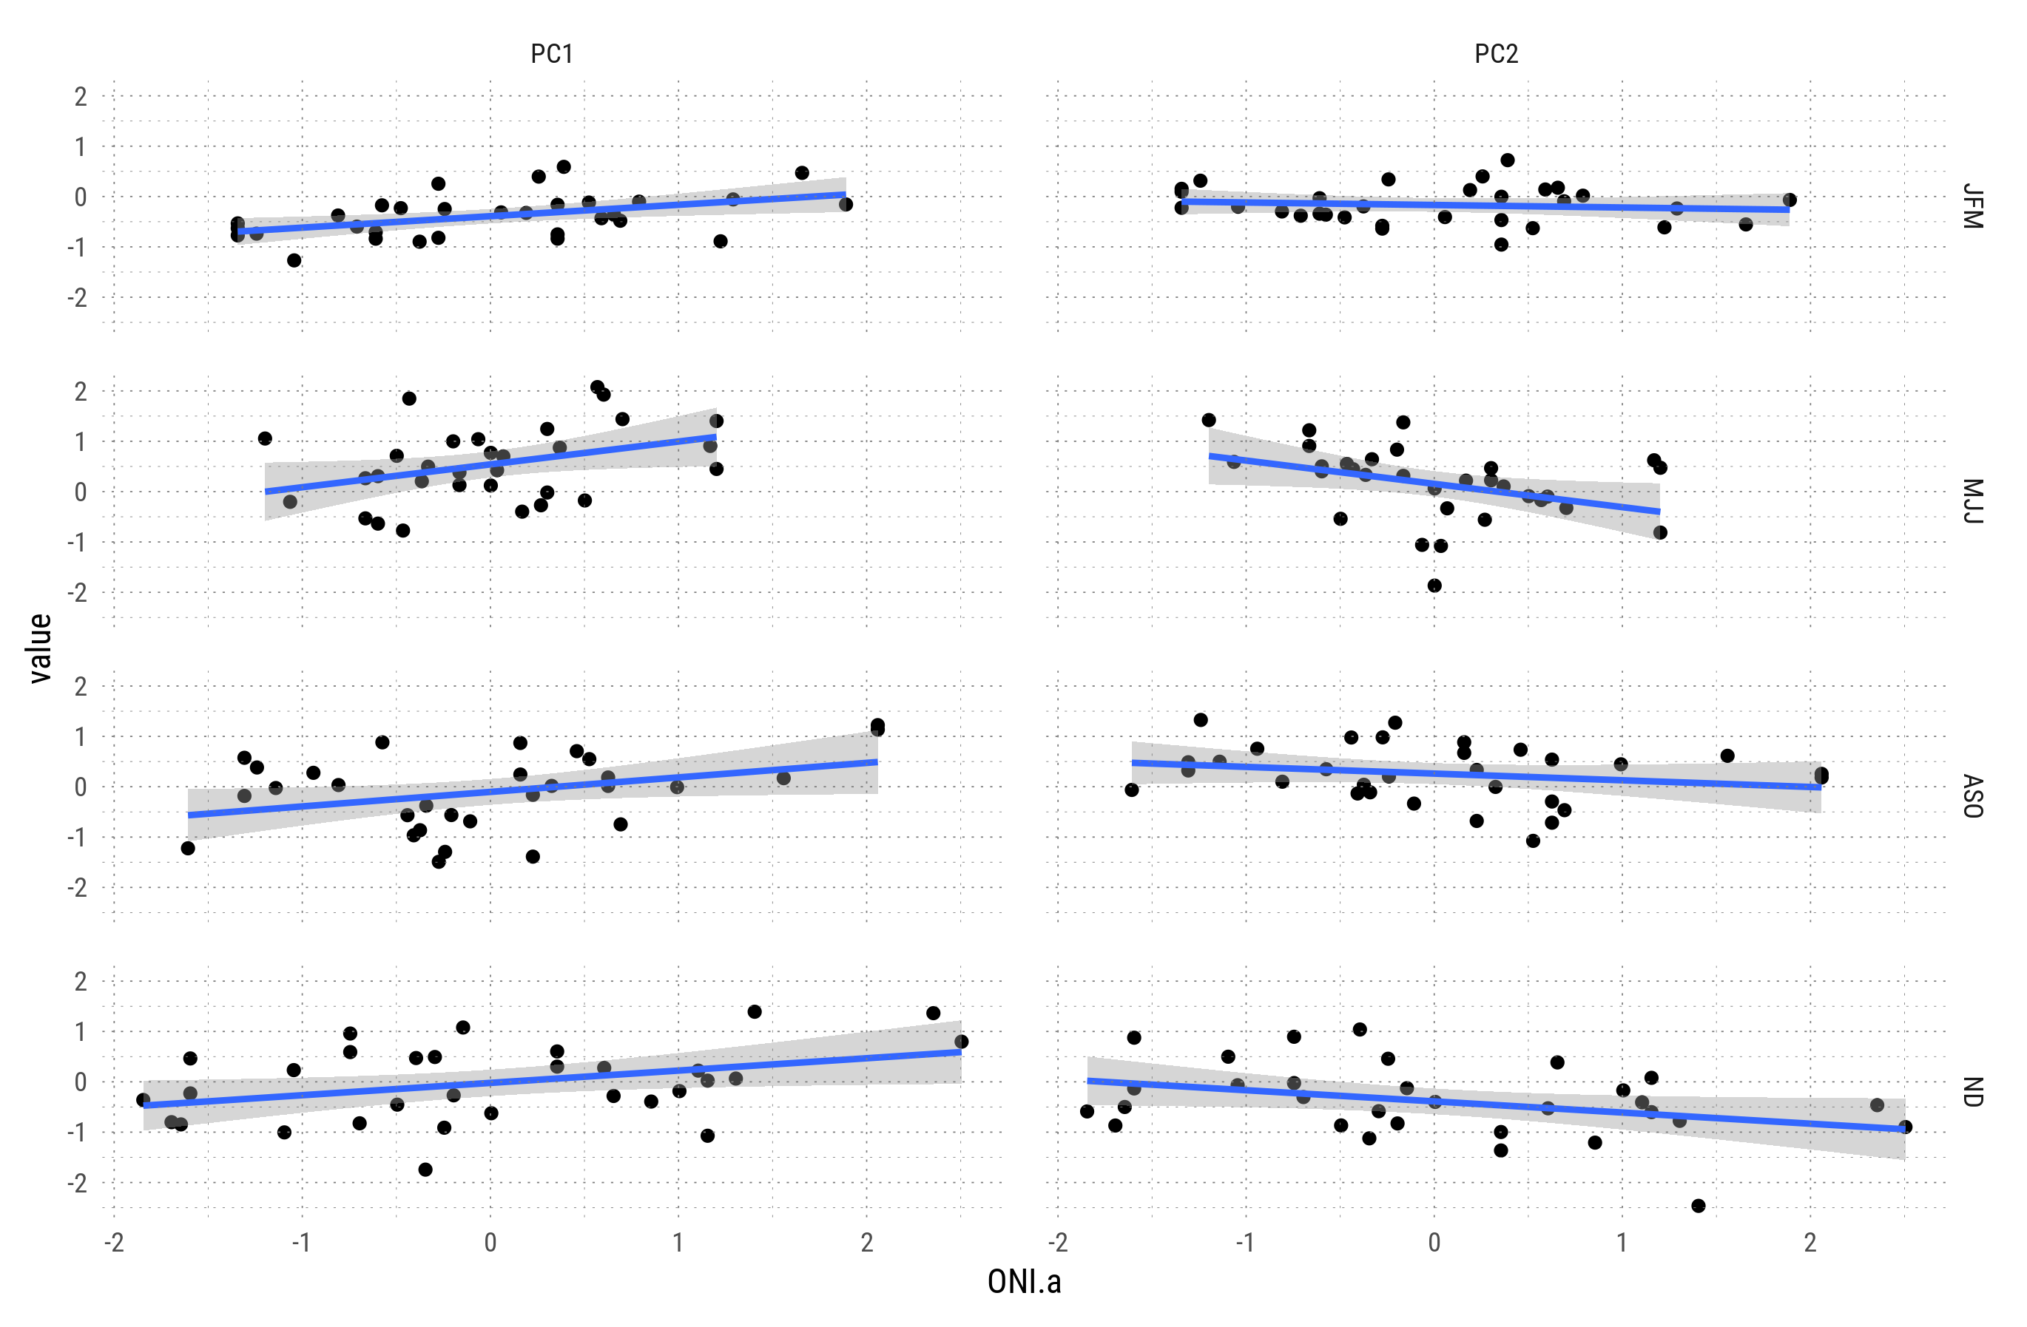
Relationship between PC1 and PC2 with ONI anomalies.

Slide 22
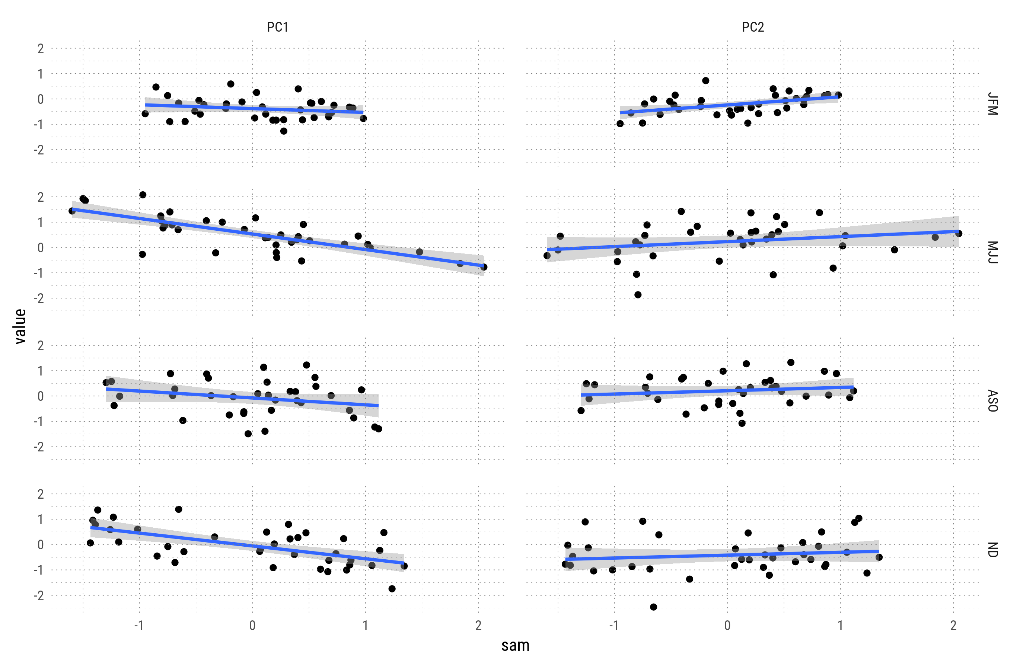
Relationship between PC1 and PC2 and SAM.

Slide 23
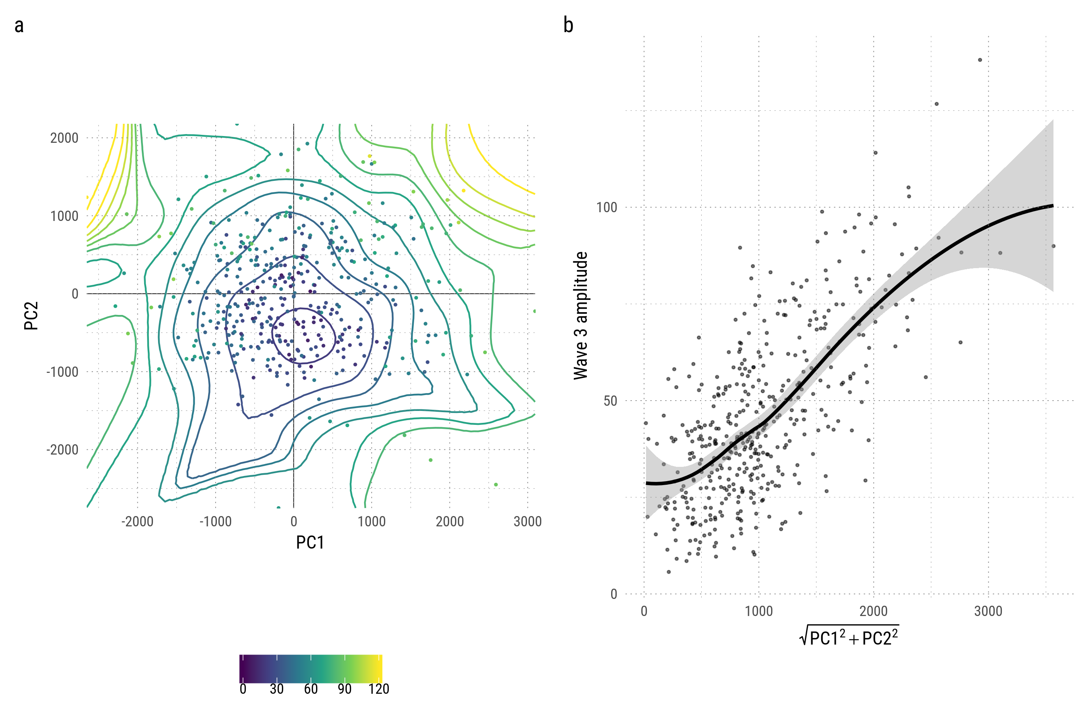
Relationship between 2 first EOFs and amplitude of wave 3. a) Monthly mean wave 3 amplitude as a function of PC1 and PC2; contours represent a smooth surface from data points b) Amplitude of monthly mean wave 3 amplitude as a function of PC1 and PC2 magnitude; line is a loess smooth.

Slide 24
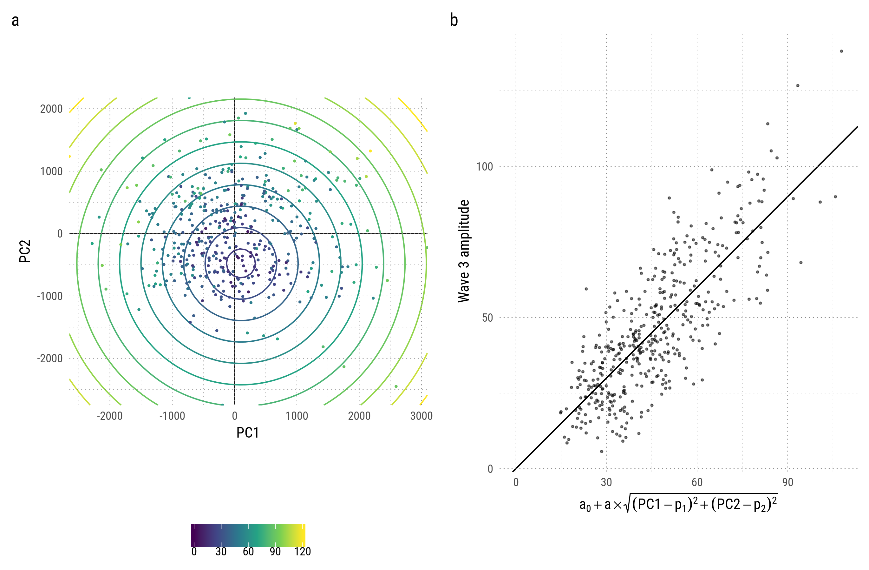
Relationship between 2 first EOFs and amplitude of wave 3. a) Monthly mean wave 3 amplitude as a function of PC1 and PC2; contours are a representation of the linear fit on the right. b) Amplitude of monthly mean wave 3 amplitude as function of the model prediction.

Slide 25
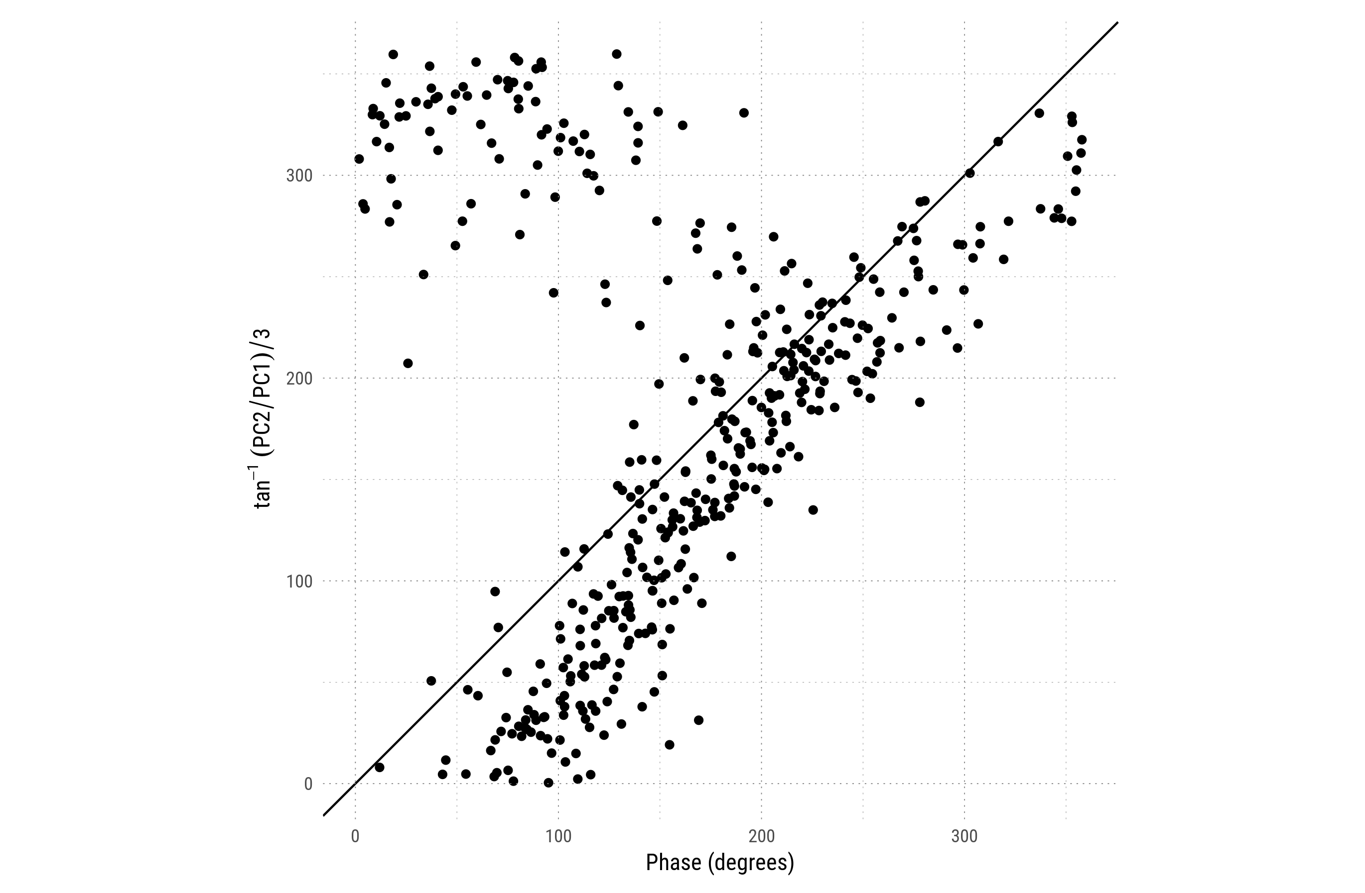
Relationship between wave 3 phase and angle betweenPC2 and PC1.

Slide 26
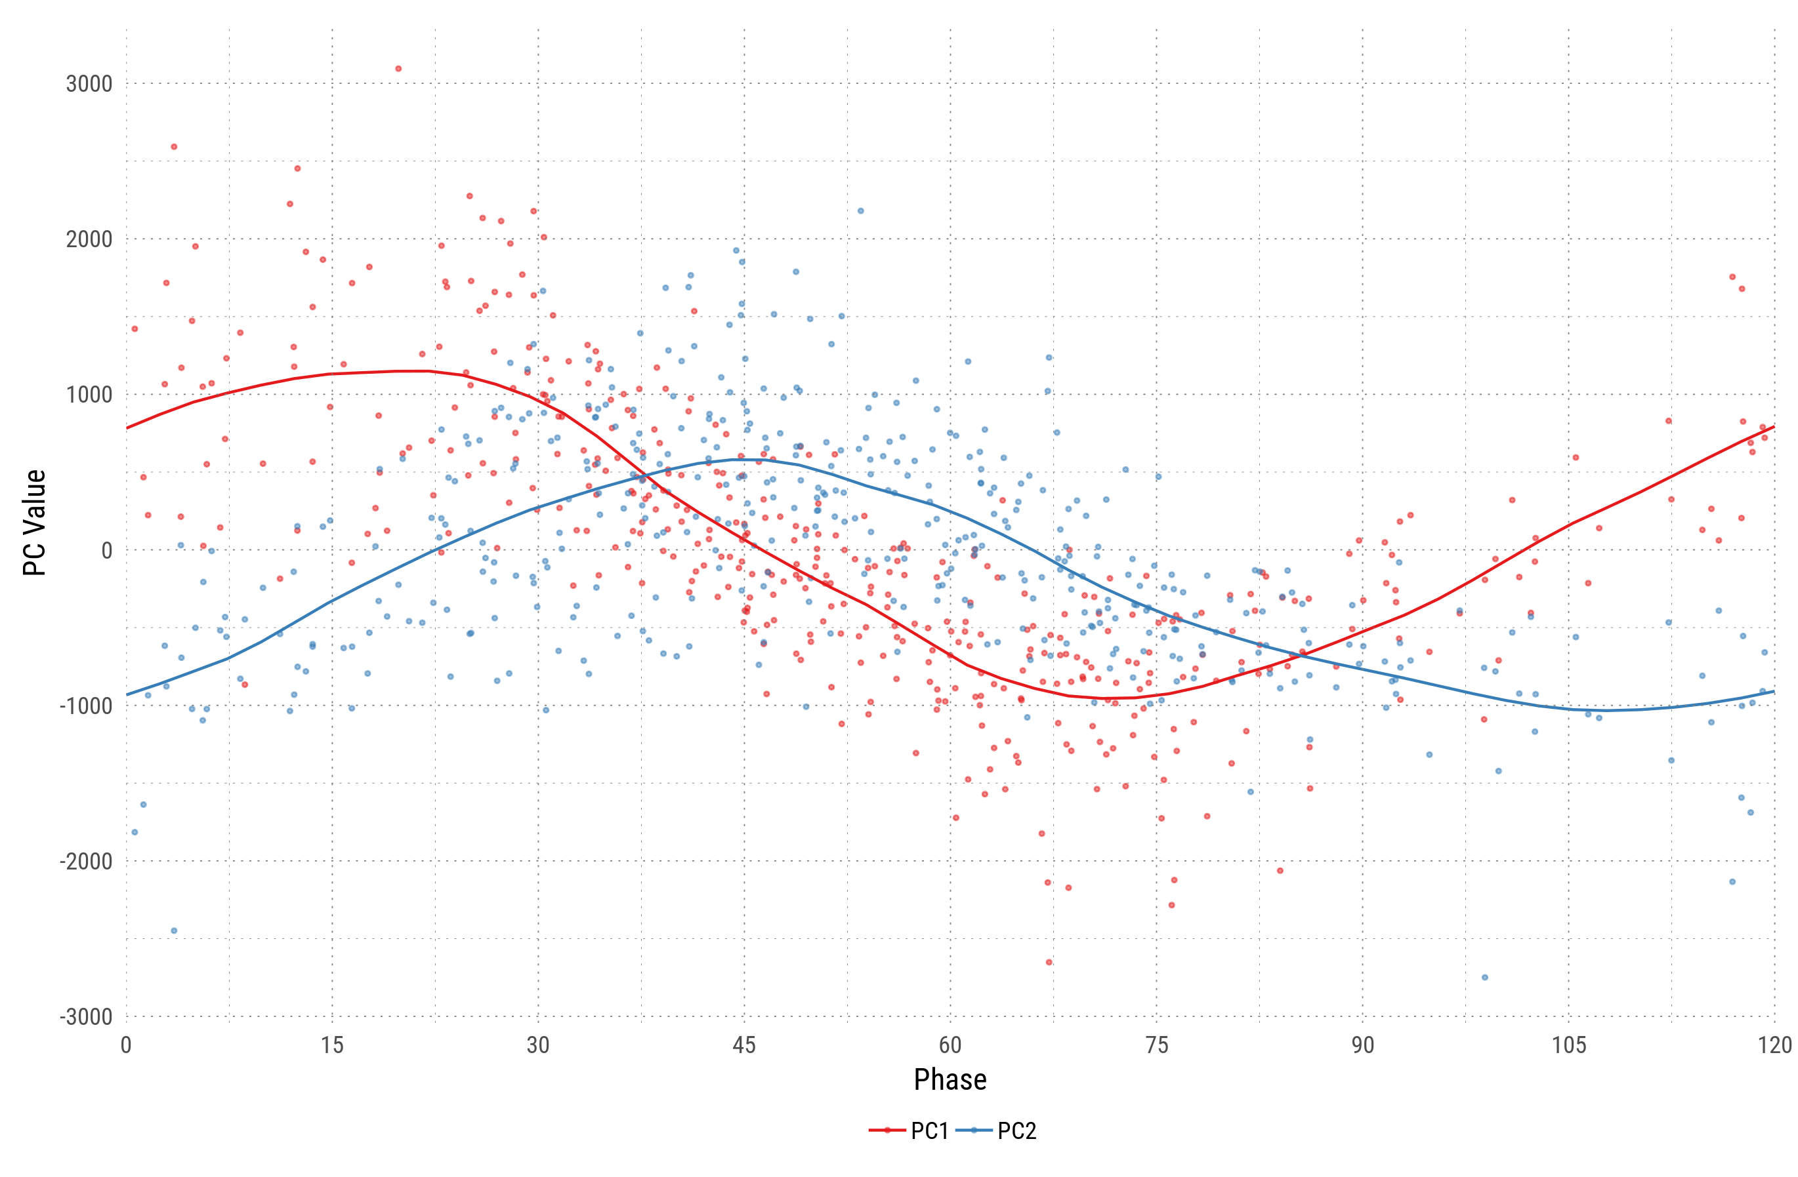
Phase of zonal wave 3 and value of PCs 1 to 2. The line is a loess smooth.

Slide 27
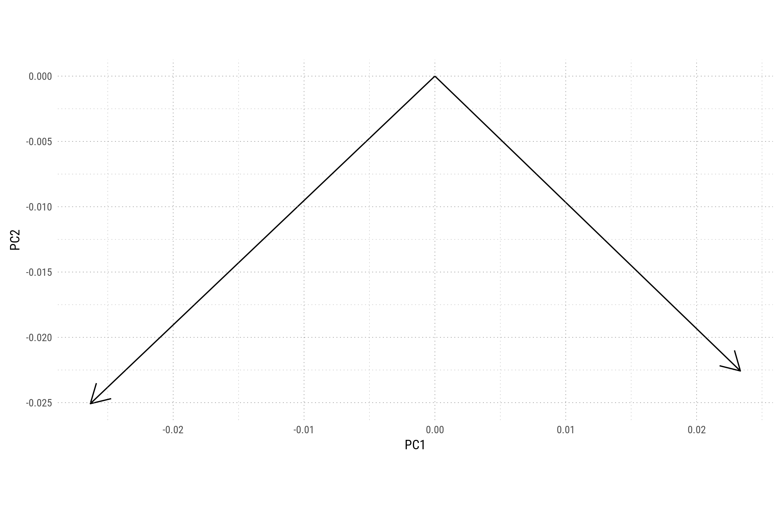
Angle between PC1 and PC2 and Real and Imaginary part of wave 3

